Slide 1
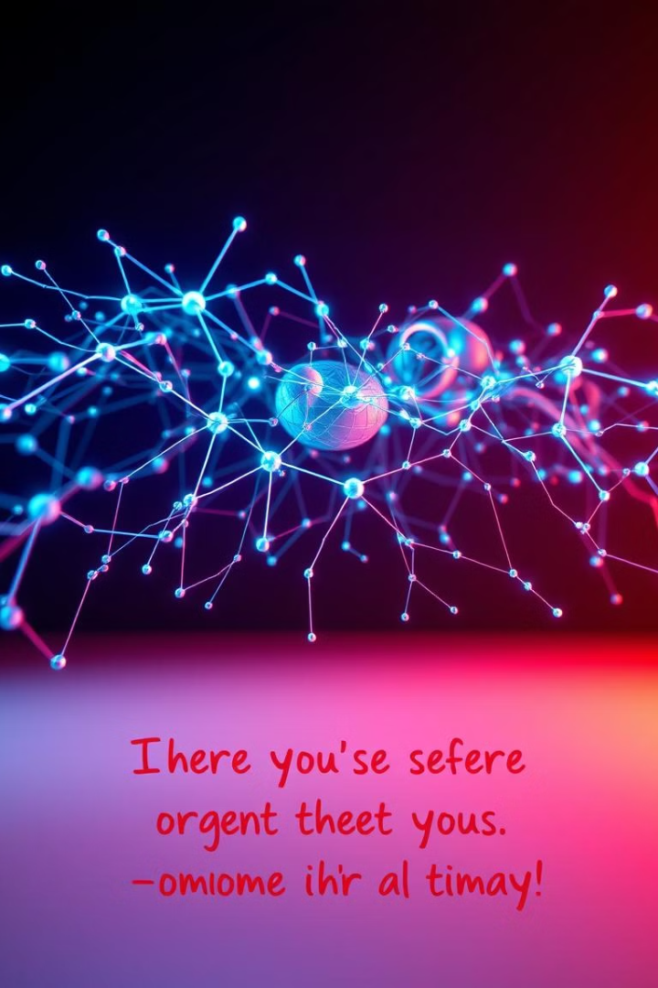

Generative AI Applications
Explore cutting-edge projects in natural language processing. This presentation covers RAG chatbot development and PDF summarization techniques.
03/09/2024
by Asli Sahin

Slide 2
Project Overview
Purpose
Scope
Technologies
Provide innovative NLP solutions for enhanced information retrieval and processing.
Focus on RAG chatbot development and PDF document summarization.
Utilize Langchain, BERT, and ChromaDB for advanced language processing tasks.

Slide 3
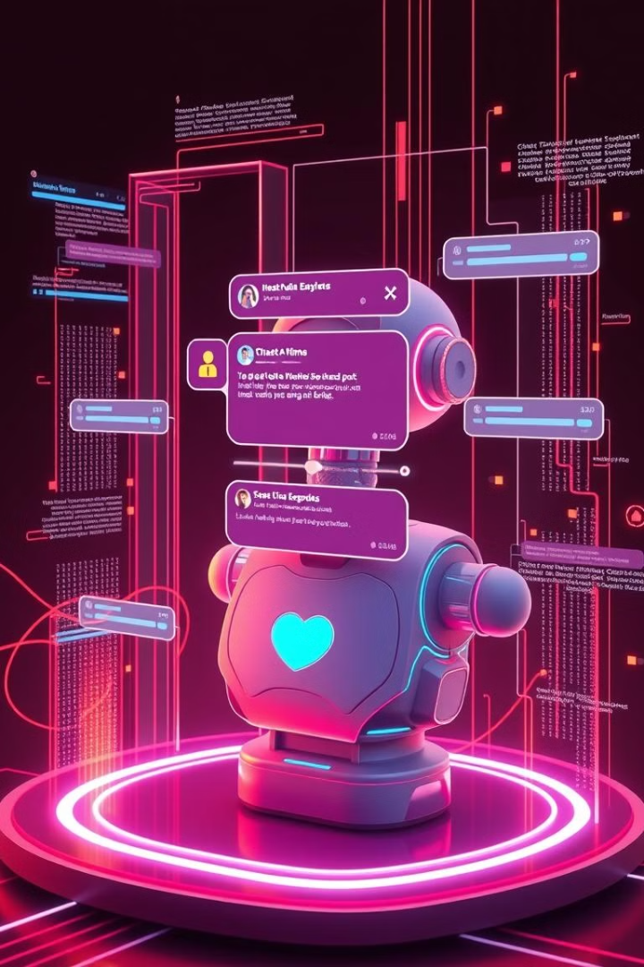
RAG Chatbot Development
1
PDF Transformation
Convert document content into chatbot-compatible format for processing.
2
Model Integration
Implement large language models like GPT and Gemini for interaction management.
3
Response Generation
Combine retrieved information with generated text for contextual answers.

Slide 4
Definition
· RAG (Retrieval-Augmented Generation): A chatbot model that combines information retrieval and text generation.
Capable of providing more accurate and contextual responses to user queries.
Process
· Transformation of PDF Document: The content of the document is converted into a format that the chatbot can understand.
· Langchain and Language Models: Large language models like GPT and Gemini are used to manage user interactions.

Slide 5

RAG Chatbot Application
Document Chunking
Divide PDF content into smaller, manageable pieces for efficient processing.
Vector Creation
Transform text chunks into vector representations for optimized search operations.
ChromaDB Integration
Store and retrieve vector data using ChromaDB for fast information access.

Slide 6




PDF Summarization Overview
Time-Saving
Quickly extract main points from lengthy documents, increasing productivity.
Content Extraction
Identify and prioritize key information from complex PDF files.
AI-Powered
Leverage advanced NLP techniques for intelligent summarization.

Slide 7
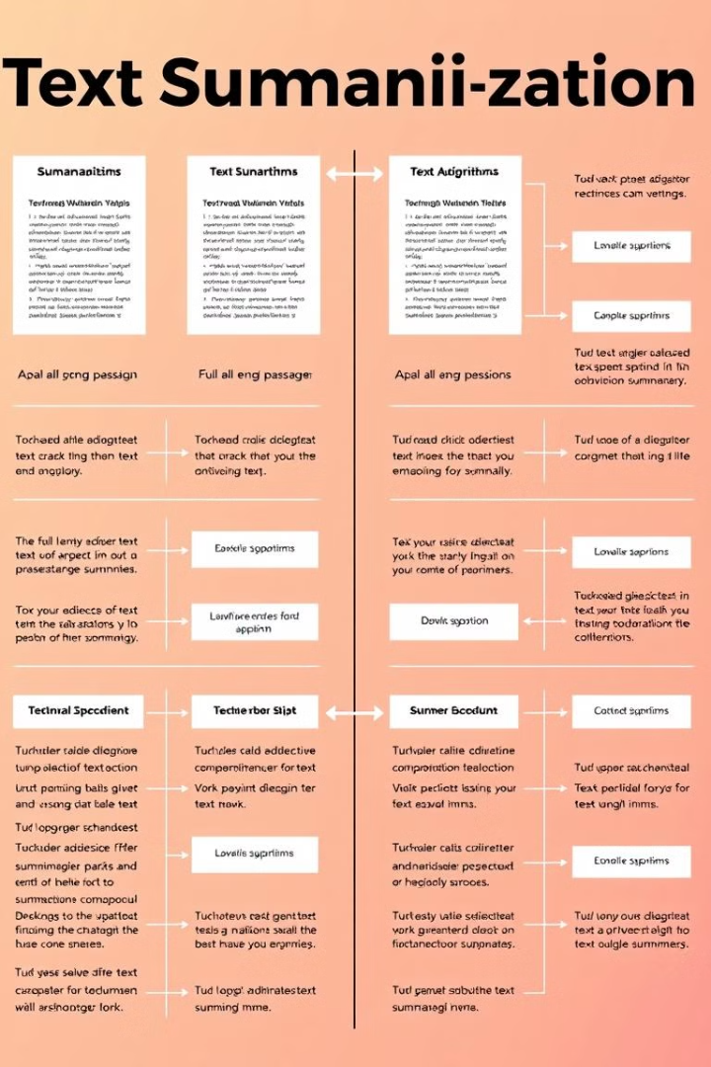



Summarization Techniques
Stuff Method
Consolidate all text for comprehensive summarization in a single pass.
Map Reduce Method
Summarize text chunks individually, then combine for final summary.
Detailed Output
Generate 1000-token summaries to capture essential information effectively.
· Presentation of Key Points: The summary is presented in bullet points to allow users to quickly grasp the information.

Slide 8

Project Evaluation and Future Work
Current Achievements
Future Enhancements
Improved NLP accuracy
Integration with more data sources
Efficient information retrieval
Enhanced user experience design
Time-saving document processing
Multi-language support expansion

Slide 9
Conclusion
· Overall Evaluation: Emphasizes that both projects provide significant contributions to the field of natural language processing.
· Future Work: Suggestions for integration with more data sources and enhancing user experience.

Slide 10

Q&A Session
1
Open Discussion
Encourage audience participation and address any questions or concerns.
2
Technical Inquiries
Provide in-depth explanations on project implementation and methodologies.
3
Future Applications
Explore potential use cases and industry applications for the developed technologies.

